Slide 1
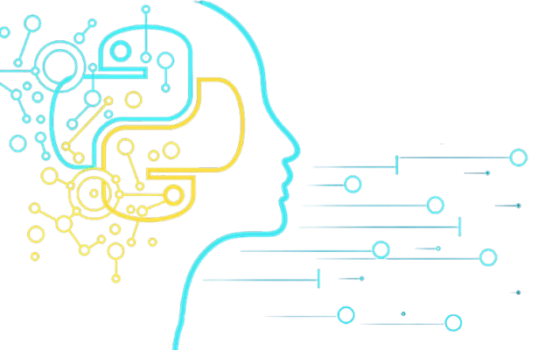
Getting Started with Data Science & Python

Slide 2

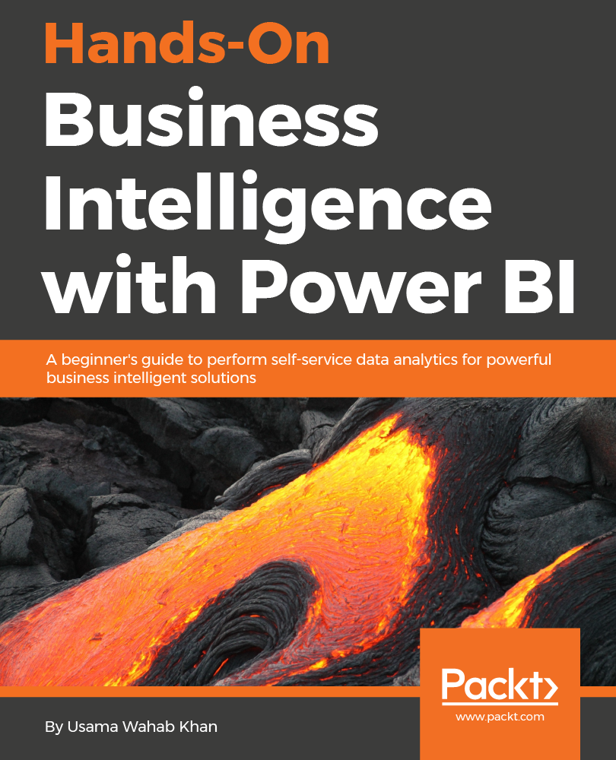













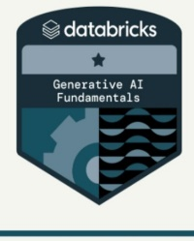


Usama Wahab Khan
Father, data Scientist, Developer/Nerd, Traveler
Twitter : @usamawahabkhan
LinkedIn : Usamawahabkhan

Slide 3


Today’s Opportunity – Your Opportunity

Slide 4

Topic
Introduction to Data Science
What is Data Science? | Module # 1
Why is Data Science Important?
Data Science Process
Core Components and Skills
Tools and Technologies
Data Science applications in industries | Module # 2
Finance & Banking
Healthcare
Retail & E-Commerce
Manufacturing & Supply Chain
Telecommunications & Media
Understanding the role of data science in decision-making and problem-solving | Module # 3
Probability & Statistics for Data Science
Introduction to Probability & Statistics for Data Science
Basic concepts in probability
Random variables and probability distributions
Key statistical concepts
Descriptive statistics Inferential statistics
Integration into machine learning and predictive analytics

Slide 5
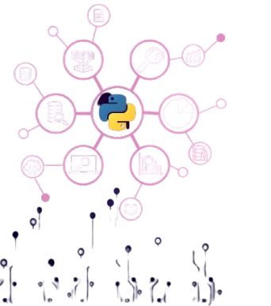
Introduction to Data Science

Slide 6
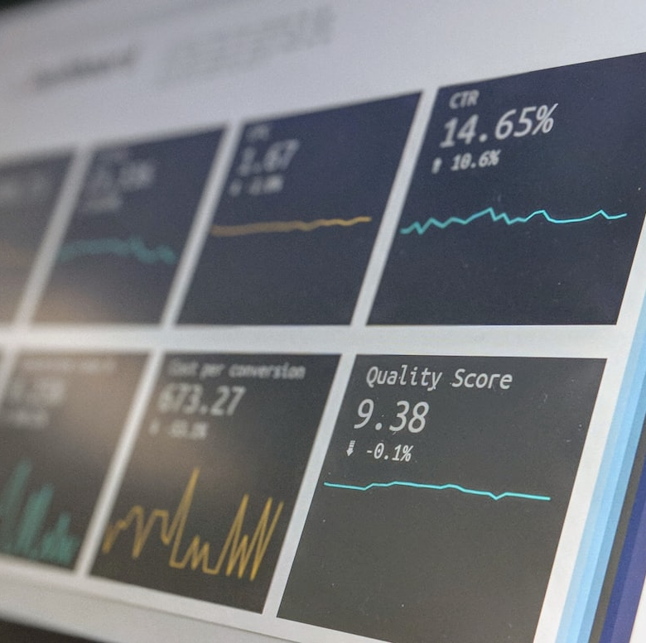
WHAT IS DATA SCIENCE?
Data Science is an interdisciplinary field that combines statistics, computer science, and domain expertise to extract meaningful insights from structured and unstructured data.

Slide 7
What is Data Science?
According to Wikipedia, Data Science is characterized as a scientific discipline that employs various scientific techniques to derive knowledge and insights from both structured and unstructured data, applying this understanding across a wide array of application domains.
This definition underscores several key elements of data science:
The primary objective of data science is to extract knowledge from data, which involves comprehending the data, uncovering hidden relationships, and constructing a model.
Data science incorporates scientific methods, including probability and statistics. Initially, when the term data science was coined, some believed it was merely a modern label for statistics. However, it has since become clear that the field encompasses a much broader scope.
The insights gained must be actionable, meaning they should provide practical applications in real-world business contexts.
It is essential to work with both structured and unstructured data. We will revisit the various types of data later in the course.
The concept of application domain is crucial, and data scientists typically require a certain level of expertise in the specific problem area, such as finance, healthcare, marketing, etc.

Slide 8
Other Related Fields
Since data is pervasive, data science itself is also a broad field, touching many other disciplines.
Databases
A critical consideration is **how to store** the data, i.e. how to structure it in a way that allows faster processing. There are different types of databases that store structured and unstructured data, which we will consider in our course.
Big Data
Often we need to store and process very large quantities of data with a relatively simple structure. There are special approaches and tools to store that data in a distributed manner on a computer cluster, and process it efficiently.
Machine Learning
One way to understand data is to **build a model** that will be able to predict a desired outcome. Developing models from data is called **machine learning**. You may want to have a look at our Machine Learning for Beginners Curriculum to learn more about it.
Artificial Intelligence
An area of machine learning known as artificial intelligence (AI) also relies on data, and it involves building high complexity models that mimic human thought processes. AI methods often allow us to turn unstructured data (e.g. natural language) into structured insights.
Visualization
Vast amounts of data are incomprehensible for a human being, but once we create useful visualizations using that data, we can make more sense of the data, and draw some conclusions. Thus, it is important to know many ways to visualize information - something that we will cover in Section 3 of our course. Related fields also include **Infographics**, and **Human-Computer Interaction** in general.

Slide 9
Roles in Data science
Data Scientist
Responsibilities: Analyzes complex data sets to extract insights, builds predictive models, and communicates findings to stakeholders. They use machine learning, statistical methods, and data visualization tools.
Skills: Strong programming skills (Python, R), knowledge of machine learning algorithms, data visualization, and statistical analysis.
2. Data Analyst
Responsibilities: Interprets data to provide actionable insights, creates reports and dashboards, and supports decision-making processes. They often work with structured data.
Skills: Proficiency in SQL, Excel, data visualization tools (Tableau, Power BI), and basic statistical analysis.
3. Data Engineer
Responsibilities: Designs, builds, and maintains data pipelines and infrastructure. They ensure data is accessible, reliable, and ready for analysis.
Skills: Strong programming skills (Python, Java, Scala), knowledge of big data technologies (Hadoop, Spark), and database management (SQL, NoSQL).
4. Machine Learning Engineer
Responsibilities: Develops and deploys machine learning models into production. They work closely with data scientists to implement models and optimize performance.
Skills: Proficiency in machine learning frameworks (TensorFlow, PyTorch), programming skills (Python, Java), and knowledge of software engineering principles.
5. Data Architect
Responsibilities: Designs and manages the architecture of data systems, ensuring they are scalable and efficient. They work on data modeling and integration.
Skills: Knowledge of database design, data warehousing, ETL processes, and cloud platforms (AWS, Azure).
6. Business Intelligence (BI) Developer
Responsibilities: Creates and manages BI solutions, including dashboards and reports. They help organizations make data-driven decisions.
Skills: Proficiency in BI tools (Tableau, Power BI), SQL, and data modeling.

Slide 10
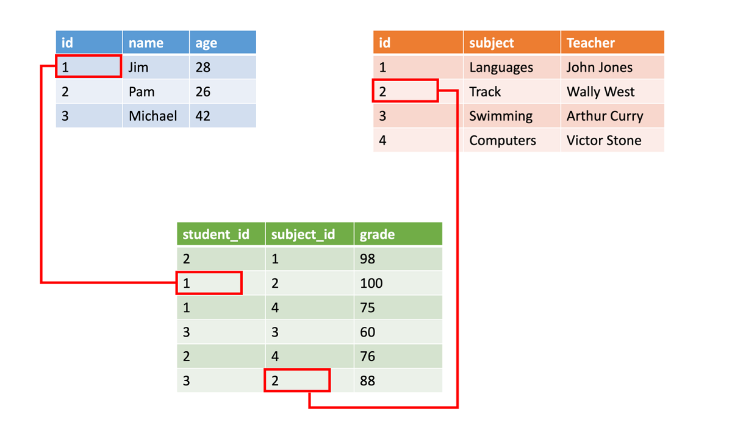
Types of Data
As we have already mentioned, data is everywhere. We just need to capture it in the right way! It is useful to distinguish between structured and unstructured data. The former is typically represented in some well-structured form, often as a table or number of tables, while the latter is just a collection of files. Sometimes we can also talk about semi-structured data, that have some sort of a structure that may vary greatly.
Structured | Semi-structured | Unstructured
List of people with their phone numbers | Wikipedia pages with links | Text of Encyclopedia Britannica
Temperature in all rooms of a building at every minute for the last 20 years | Collection of scientific papers in JSON format with authors, data of publication, and abstract | File share with corporate documents
Data for age and gender of all people entering the building | Internet pages | Raw video feed from surveillance camera

Slide 11
Types of Data
As we have already mentioned, data is everywhere. We just need to capture it in the right way! It is useful to distinguish between structured and unstructured data. The former is typically represented in some well-structured form, often as a table or number of tables, while the latter is just a collection of files. Sometimes we can also talk about semi-structured data, that have some sort of a structure that may vary greatly.
{
"firstName": "Quinn",
"lastName": "Anderson",
"age": "23",
"hobbies": [
{ "type": "Sports", "value": "Golf" },
{ "type": "Leisure", "value": "Reading" },
{ "type": "Leisure", "value": "Guitar" }
]
}
Structured | Semi-structured | Unstructured
List of people with their phone numbers | Wikipedia pages with links | Text of Encyclopedia Britannica
Temperature in all rooms of a building at every minute for the last 20 years | Collection of scientific papers in JSON format with authors, data of publication, and abstract | File share with corporate documents
Data for age and gender of all people entering the building | Internet pages | Raw video feed from surveillance camera

Slide 12
Where to get Data
Structured
Internet of Things (IoT), including data from different sensors, such as temperature or pressure sensors, provides a lot of useful data. For example, if an office building is equipped with IoT sensors, we can automatically control heating and lighting in order to minimize costs.
Surveys that we ask users to complete after a purchase, or after visiting a web site.
Analysis of behavior can, for example, help us understand how deeply a user goes into a site, and what is the typical reason for leaving the site.
Unstructured
Texts can be a rich source of insights, such as an overall sentiment score, or extracting keywords and semantic meaning.
Images or Video. A video from a surveillance camera can be used to estimate traffic on the road, and inform people about potential traffic jams.
Web server Logs can be used to understand which pages of our site are most often visited, and for how long.
Semi-structured
Social Network graphs can be great sources of data about user personalities and potential effectiveness in spreading information around.
When we have a bunch of photographs from a party, we can try to extract Group Dynamics data by building a graph of people taking pictures with each other.

Slide 13
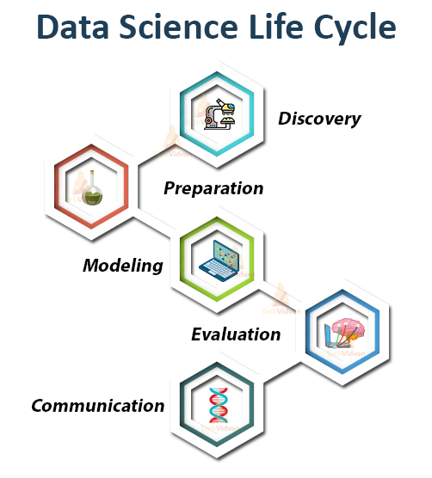
Data Science Life-Cycle
Data Collection:
Gathering raw data from various sources.
Data Preparation:
Applying statistical methods to explore the data.
Modelling:
Building predictive or descriptive models using machine learning algorithms.
Interpretation:
Translating models and patterns into actionable insights.

Slide 14
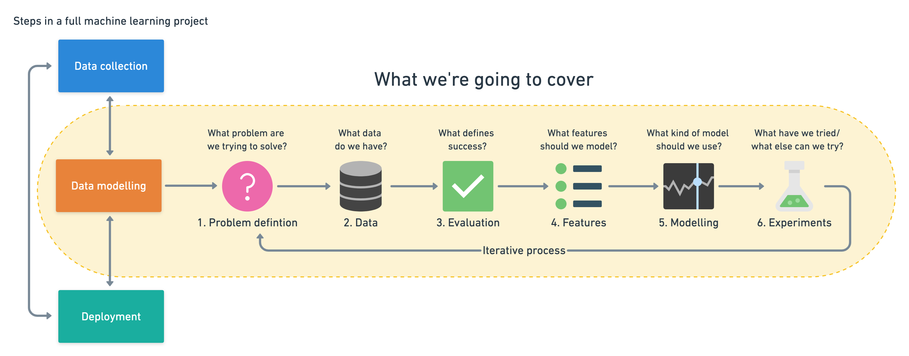
Data Science Life-Cycle

Slide 15
Why is Data Science Important?

Slide 16
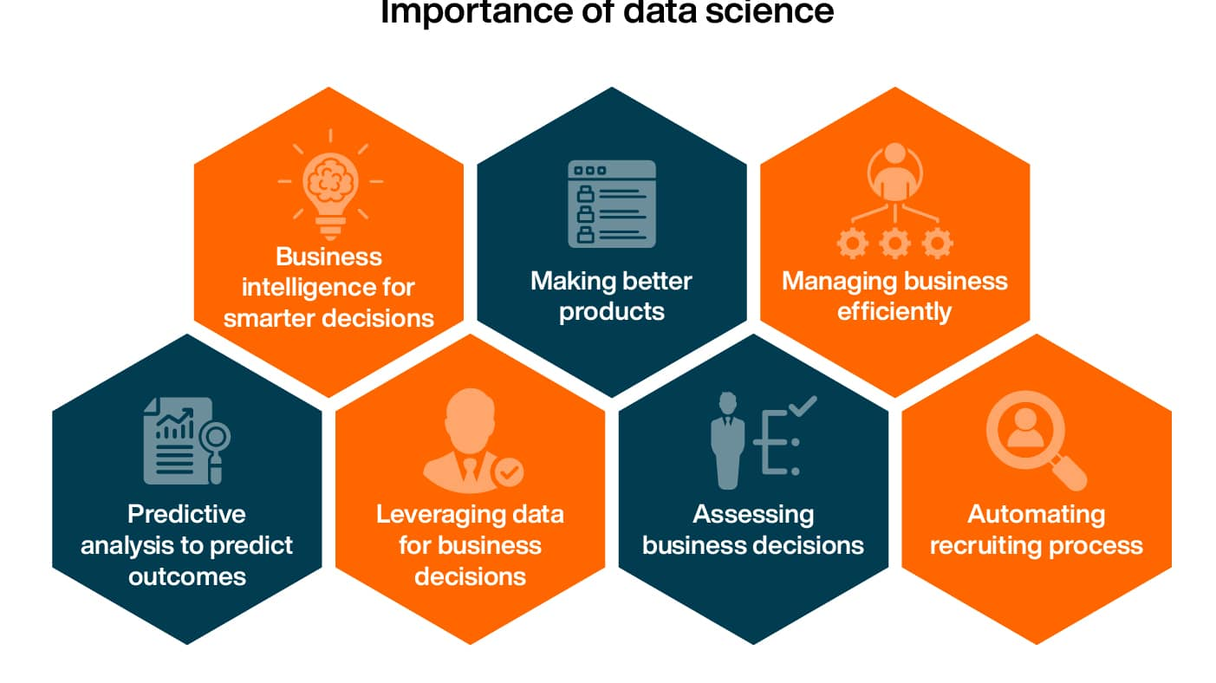

Slide 17
The Data Revolution & Digital Transformation

Slide 18
The Data Revolution & Digital TransformationAgenda
Data Explosion:
Billions of data points generated every day by online activities, sensors, social media, and smart devices.
Digital Transformation:
Organizations are rapidly shifting from manual, intuition-based decisions to data-driven strategies.
Data:
The New Oil:Just as oil powered the industrial revolution, data now fuels innovation, efficiency, and growth.

Slide 19

Driving Innovation through Data Science
Foundation for AI & Machine Learning:
Data science drives the development of intelligent systems through training models on large datasets.
Real-Time Decision-Making:
Analytics and streaming data enable organizations to respond immediately to changes.
Emerging Technologies:
Integration with IoT, blockchain, and augmented/virtual reality creates new business models and opportunities.
Inspiring Creativity:
Being data-driven opens avenues in research, product development, and creative problem solving.

Slide 20
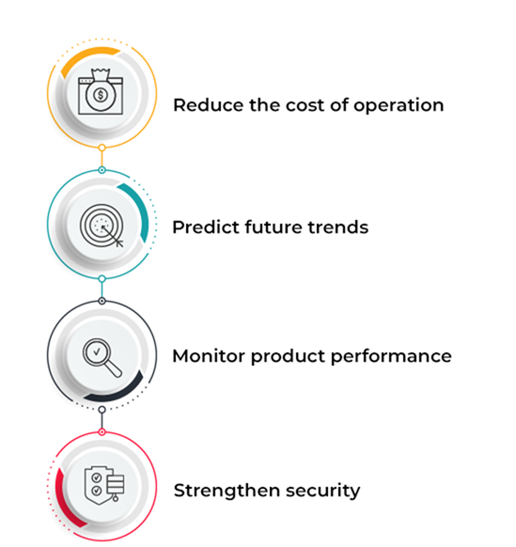
Importance of data analytics

Slide 21
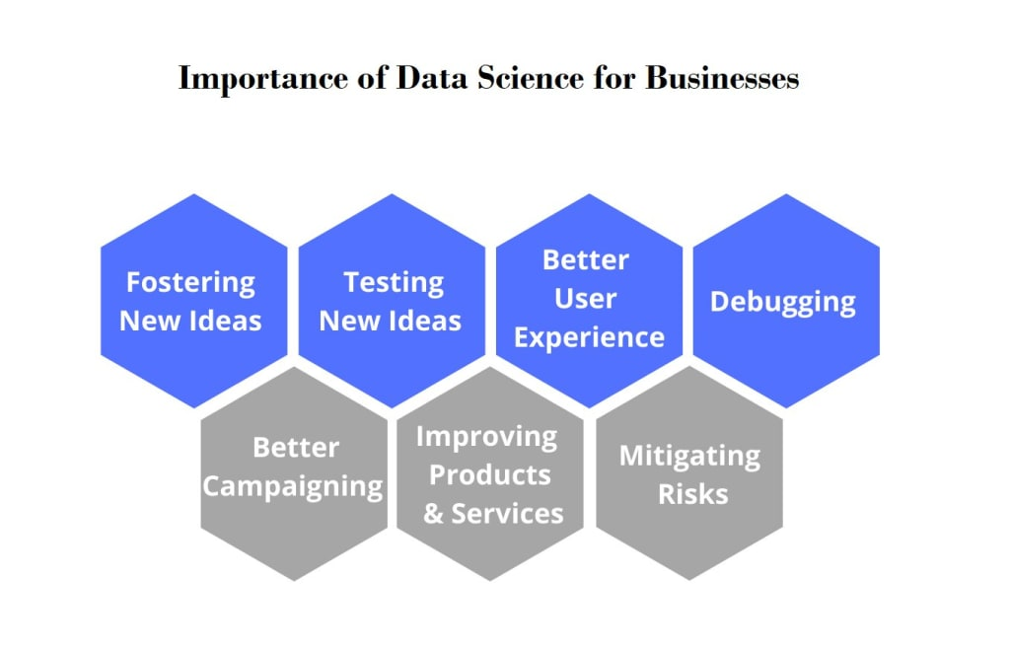

Slide 22
Data Science Applications in Industries

Slide 23
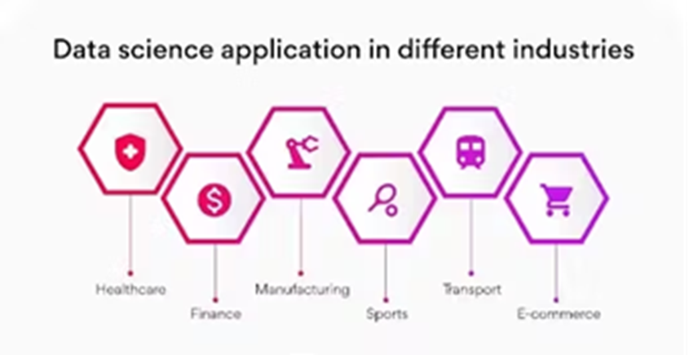

Slide 24
Data Science Applications in Industries
Healthcare
Data science is playing a crucial role in transforming healthcare, leading to improved patient outcomes, reduced costs, and more efficient healthcare systems.
Predictive Diagnostics
Identifying high-risk patients: By analysing patient data, including electronic health records, genetic information, and lifestyle factors, data science can help predict the likelihood of developing specific diseases.
Enabling early intervention: Predictive models can identify patients who are at risk of developing a disease, allowing for timely interventions and preventive care.
Improving diagnostic accuracy: Machine learning algorithms can analyse medical images, such as X-rays, MRIs, and CT scans, to detect abnormalities and assist clinicians in making more accurate diagnoses. Personalized Medicine

Slide 25
Data Science Applications in Industries
Healthcare
2. Personalized Medicine
Tailoring treatment plans: Data science enables the development of personalized treatment plans based on individual patient characteristics, such as genetic makeup, medical history, and treatment response.
Optimizing drug dosages: By analysing patient data, clinicians can determine the optimal drug dosage for each individual, maximizing treatment effectiveness and minimizing side effects.
Predicting treatment response: Machine learning models can predict how patients will respond to different treatments, helping clinicians select the most appropriate therapy.

Slide 26

Data Science Applications in Industries
Healthcare
3. Drug Discovery and Development
Accelerating drug discovery: Data science can help identify potential drug targets, predict drug efficacy and safety, and optimize clinical trial design, accelerating the drug discovery process.
Repurposing existing drugs: By analyzing large datasets, researchers can identify new uses for existing drugs, reducing the time and cost of drug development.
Personalizing drug development: Data science can help identify patient subgroups that are most likely to respond to a particular drug, enabling the development of more targeted and effective therapies.

Slide 27

Data Science Applications in Industries
Finance
Data science is revolutionizing the financial industry, enabling institutions to manage risk, detect fraud, and provide personalized services.
Fraud Detection
Identifying fraudulent transactions: Machine learning algorithms can analyze transaction data to detect patterns and anomalies that may indicate fraud.
Reducing false positives: Data science can help minimize false positives, reducing the number of legitimate transactions that are incorrectly flagged as fraudulent.
Improving fraud prevention: By continuously learning from new data, fraud detection systems can adapt to evolving fraud tactics and improve their effectiveness.

Slide 28

Data Science Applications in Industries
Finance
Fraud Detection
Identifying fraudulent transactions: Machine learning algorithms can analyze transaction data to detect patterns and anomalies that may indicate fraud.
Reducing false positives: Data science can help minimize false positives, reducing the number of legitimate transactions that are incorrectly flagged as fraudulent.
Improving fraud prevention: By continuously learning from new data, fraud detection systems can adapt to evolving fraud tactics and improve their effectiveness.

Slide 29

Data Science Applications in Industries
Finance
Risk Management
Assessing credit risk: Data science can be used to evaluate the creditworthiness of borrowers based on their financial history, loan application data, and other factors.
Predicting market risk: By analyzing market data, economic indicators, and other variables, data science can help forecast market trends and assess investment risk.
Optimizing portfolio management: Data-driven models can help optimize investment portfolios by identifying the optimal asset allocation and managing risk.

Slide 30

Data Science Applications in Industries
Finance
Personalized Financial Services
Tailoring financial products: Data science can help financial institutions understand customer needs and preferences, enabling them to offer personalized financial products and services.
Providing personalized advice: By analyzing customer data, financial advisors can provide tailored investment advice and recommendations.
Improving customer experience: Data-driven insights can help financial institutions enhance customer interactions, streamline processes, and improve overall customer satisfaction.

Slide 31
Data Science Applications in Industries
Marketing
Data science is transforming marketing, enabling businesses to understand customer behaviour, personalize campaigns, and optimize marketing spend.
Customer Segmentation
Identifying customer groups: By analysing customer data, marketers can segment customers into distinct groups based on their demographics, preferences, and behaviour.
Tailoring marketing campaigns: Data science enables the development of targeted marketing campaigns that resonate with specific customer segments.
Improving customer engagement: Personalized marketing messages can increase customer engagement, leading to higher conversion rates and brand loyalty.

Slide 32

Data Science Applications in Industries
Targeted Advertising
Delivering personalized ads: Data science can help identify the most relevant ads to show to individual customers based on their interests, browsing history, and online behavior.
Optimizing ad spend: By analyzing campaign performance data, marketers can optimize their ad spend and allocate resources to the most effective channels.
Increasing ad effectiveness: Targeted advertising can improve ad effectiveness, leading to higher click-through rates and conversion rates.

Slide 33
Data Science Applications in Industries
Recommendation Systems
Suggesting relevant products: Recommendation systems analyze customer data to suggest products or services that a customer is likely to be interested in.
Enhancing customer experience: Personalized recommendations can enhance the customer experience, making it easier for customers to find what they are looking for.
Driving sales: By promoting relevant products, recommendation systems can increase sales and revenue.

Slide 34
Data Science Applications in Industries
Transportation
Data science is revolutionizing the transportation industry, leading to safer, more efficient, and more sustainable transportation systems.
Route Optimization
Finding optimal routes: Data science can be used to determine the most efficient routes for vehicles, considering factors such as traffic conditions, weather, and delivery schedules.
Reducing fuel consumption: Optimized routes can help reduce fuel consumption, lowering transportation costs and minimizing environmental impact.
Improving delivery times: Efficient routing can help businesses improve delivery times and enhance customer satisfaction.

Slide 35
Data Science Applications in Industries
Traffic Management
Predicting traffic flow: Data science can be used to forecast traffic conditions and identify potential congestion points.
Optimizing traffic signals: By analyzing traffic data, transportation authorities can optimize traffic signal timing to improve traffic flow and reduce congestion.
Enhancing safety: Data-driven insights can help identify high-risk areas and implement measures to improve road safety.

Slide 36
Data Science Applications in Industries
Autonomous Vehicles
Enabling self-driving cars: Data science is a core technology behind autonomous vehicles, enabling them to perceive their environment, make decisions, and navigate without human intervention.
Improving safety: Self-driving cars have the potential to significantly reduce accidents caused by human error.
Increasing efficiency: Autonomous vehicles can optimize traffic flow, reduce congestion, and improve fuel efficiency.

Slide 37
Data Science Applications in Industries
E-commerce
Data science is transforming the e-commerce industry, enabling businesses to personalize the shopping experience, optimize pricing, and detect fraud.
Personalized Shopping Experiences
Tailoring website content: Data science can help personalize website content, product recommendations, and search results based on individual customer preferences.
Creating personalized offers: By analyzing customer data, e-commerce businesses can create targeted offers and promotions that are more likely to resonate with individual customers.
Enhancing customer satisfaction: Personalized shopping experiences can improve customer satisfaction and drive customer loyalty.

Slide 38
Data Science Applications in Industries
Price Optimization
Dynamic pricing: Data science enables e-commerce businesses to dynamically adjust prices based on factors such as demand, competition, and customer behavior.
Maximizing revenue: Optimized pricing strategies can help businesses maximize revenue and profitability.
Gaining competitive advantage: By using data-driven pricing, e-commerce businesses can gain a competitive edge in the market.

Slide 39
Data Science Applications in Industries
Fraud Detection
Identifying fraudulent transactions: Machine learning algorithms can analyze transaction data to detect patterns and anomalies that may indicate fraud.
Preventing financial losses: Effective fraud detection systems can help e-commerce businesses minimize financial losses and protect their customers.
Building customer trust: By ensuring a safe and secure shopping environment, e-commerce businesses can build customer trust and loyalty

Slide 40
Data Science Applications in Industries
Manufacturing
Data science is revolutionizing manufacturing, leading to increased efficiency, reduced costs, and improved product quality.
Predictive Maintenance
Predicting equipment failures: By analyzing sensor data and other information, data science can help predict when equipment is likely to fail.
Preventing downtime: Predictive maintenance enables manufacturers to schedule maintenance proactively, minimizing downtime and production disruptions.
Reducing maintenance costs: By performing maintenance only when needed, manufacturers can reduce maintenance costs and improve operational efficiency.

Slide 41
Data Science Applications in Industries
Quality Control
Automating defect detection: Machine learning algorithms can analyze images, sensor data, and other information to detect product defects automatically.
Improving product quality: Automated defect detection can help manufacturers improve product quality, reduce waste, and enhance customer satisfaction.
Reducing inspection costs: Automated quality control can reduce the need for manual inspection, lowering costs and increasing efficiency.

Slide 42
Data Science Applications in Industries
Process Optimization
Identifying inefficiencies: Data science can help manufacturers identify bottlenecks, inefficiencies, and areas for improvement in their production processes.
Optimizing production parameters: By analyzing production data, manufacturers can optimize process parameters to improve efficiency, reduce waste, and lower costs.
Increasing throughput: Optimized production processes can help manufacturers increase throughput and meet growing demand.

Slide 43
Data Science Applications in Industries
Energy
Data science is transforming the energy sector, enabling companies to optimize energy production, distribution, and consumption.
Smart Grids
Optimizing energy distribution: Data science can help optimize the distribution of electricity through smart grids, improving efficiency and reliability.
Balancing supply and demand: By forecasting energy demand and supply, smart grids can balance the two in real-time, preventing blackouts and ensuring grid stability.
Integrating renewable energy: Data science can facilitate the integration of renewable energy sources, such as solar and wind power, into the grid.

Slide 44
Data Science Applications in Industries
Renewable Energy Forecasting
Predicting energy output: Data science can be used to forecast the energy output of renewable energy sources, such as solar and wind power, based on weather patterns and other factors.
Improving grid management: Accurate energy forecasts can help grid operators manage the variability of renewable energy sources and ensure grid stability.
Optimizing energy storage: Data-driven forecasts can help optimize the use of energy storage systems, such as batteries, to store excess energy and release it when needed.

Slide 45

Data Science Applications in Industries
Energy Efficiency
Identifying energy waste: Data science can help identify areas where energy is being wasted in buildings, industrial processes, and transportation systems.
Optimizing energy consumption: By analyzing energy usage patterns, data science can help optimize energy consumption and reduce costs.
Promoting sustainability: Data-driven insights can help businesses and individuals make more sustainable energy choices, reducing their environmental impact.

Slide 46
The Importance of Data Science in Predictive Analytics and AI

Slide 47
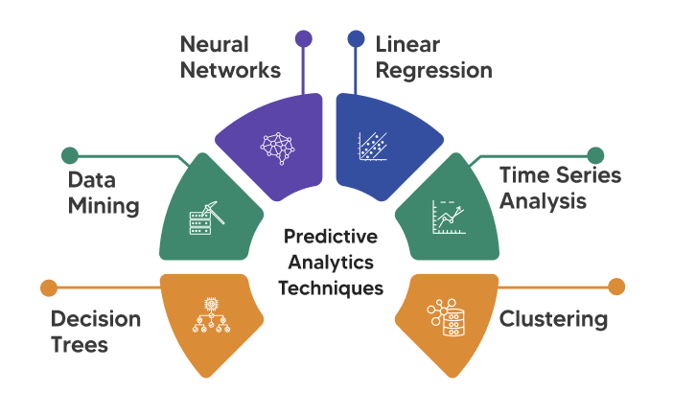
The Importance of Data Science in Predictive Analytics and AI

Slide 48
The Importance of Data Science in Predictive Analytics and AI
Predictive Analytics
Definition: Predictive analytics is a branch of data science that uses historical data, statistical algorithms, and machine learning techniques to identify patterns and predict future outcomes.
Key Components:
Data: High-quality, relevant data is essential for accurate predictions.
Statistical Models: Regression, time series analysis, and other statistical techniques are used to model relationships in the data.
Machine Learning: Algorithms that learn from data to improve predictions over time.
Applications: Demand forecasting, risk assessment, customer churn prediction, and fraud detection.

Slide 49
Importance of Data Science in Predictive Analytics
1. Improved Accuracy and Reliability
01
Enhanced Decision-Making
02
Automation and Efficiency
03
Risk Management.
04

Slide 50
Importance of Data Science in AI
1. Enabling Machine Learning
Data science provides the foundation for machine learning, which is a core component of AI.
Data scientists design and develop machine learning algorithms, train them on data, and evaluate their performance.
2. Driving Innovation
Data science fuels AI innovation by enabling the development of new algorithms and techniques.
Researchers and data scientists are constantly pushing the boundaries of AI, leading to breakthroughs in areas such as deep learning, natural language processing, and computer vision.
3. Solving Complex Problems
AI, powered by data science, can solve complex problems that are beyond the capabilities of traditional approaches.
Data scientists leverage AI techniques to tackle challenges in areas such as healthcare, finance, and transportation.
4. Ethical Considerations
Data science plays a crucial role in addressing the ethical considerations associated with AI.
Data scientists are responsible for ensuring that AI systems are developed and used in a responsible and ethical manner, addressing issues such as bias, fairness, and privacy.

Slide 51
Introduction to probability and statistics in data science

Slide 52

Why Probability and Statistics Matter in Data Science

Slide 53
Why Probability and Statistics Matter in Data Science
Data as a Source of Uncertainty:
Data is rarely perfect; it comes with uncertainty that must be modeled.
Decision-Making and Predictions:
Probability helps quantify uncertainty and risk.
Statistics provides methods to interpret samples and make inferences
about the larger population.
Foundation for Machine Learning:
Many algorithms rely on statistical models to learn patterns and
make predictions.

Slide 54
Basic Probability Concepts

Slide 55
Probability and Random Variables
Probability is a number between 0 and 1 that expresses how probable an event is. It is defined as a number of positive outcomes (that lead to the event), divided by total number of outcomes, given that all outcomes are equally probable. For example, when we roll a dice, the probability that we get an even number is 3/6 = 0.5.

Slide 56
Basic Probability Concepts
Key Definitions:
Experiment: A process with uncertain outcomes.
Event: A set of outcomes (e.g., rolling a 4 on a die).
Sample Space: All possible outcomes of an experiment.
Probability Axioms:
Probabilities range from 0 to 1.
The sum of probabilities of all mutually exclusive events equals 1.
Conditional Probability:
Formula: P(A|B) = P(A ∩ B) / P(B)
Importance in understanding sequential events.

Slide 57
Random Variables and Probability Distributions
Random Variables:
Discrete: Countable outcomes (e.g., number of defective items).
Continuous: Infinite, uncountable outcomes (e.g., height, temperature).
Common Distributions:
Discrete Examples: Binomial, Poisson.
Continuous Examples: Normal (Gaussian), Exponential.
Key Concepts:
Probability Mass Function (PMF): For discrete variables.
Probability Density Function (PDF): For continuous variables.
Cumulative Distribution Function (CDF): Used to determine probabilities up to a certain value.

Slide 58
Inferential Statistics and Hypothesis Testing
Basic Concepts:
Population vs. Sample: Understanding the difference and why sampling is necessary.
Parameter Estimation: Estimating population parameters (
e.g., mean, proportion) from sample data.
Hypothesis Testing:
Null Hypothesis (H₀) vs. Alternative Hypothesis (H₁).
P-value and significance level (α), commonly 0.05.
Type I and Type II Errors.
Confidence Intervals:
Estimating the range within which a population parameter lies with a
given level of confidence.

Slide 59
Statistical Modeling and Regression Analysis
Introduction to Regression:
Simple Linear Regression: Modeling the relationship between two
variables.
Multiple Regression: Extending to more than one predictor.
Key Aspects:
Estimation of coefficients using the least squares method.
Interpretation of R-squared as a measure of model fit.
Beyond Regression:
Logistic Regression for classification tasks.
Non-linear models and advanced machine learning techniques.

Slide 60
Integration of Probability and Statistics in Data Science
Foundation for Machine Learning:
Algorithms in machine learning are often based on statistical models.
Probability helps in understanding model uncertainty and in making predictions.
Real-World Applications:
Forecasting (e.g., sales, stock market trends).
Risk assessment in finance and insurance.
Recommender systems and customer segmentation.
Evaluation Metrics:
Use statistical measures to validate model performance.
Importance of understanding overfitting, underfitting, and bias-variance trade-offs.

Slide 61

Tools and Libraries for Statistical Analysis
Programming Languages:
Python: Widely used with powerful libraries.
R: Preferred for statistical computing and graphics.
Key Libraries:
Python: NumPy, SciPy, Pandas, Statsmodels, scikit-learn.
R: dplyr, ggplot2, caret, randomForest.
Visualization Tools:
Matplotlib, Seaborn, Plotly for Python.
ggplot2 in R.

Slide 62




Q&A
Ask the team anything
Usama Wahab Khan
Twitter : @usamawahabkhan
LinkedIn : Usamawahabkhan
Notes:
https://www.microsoft.com/en-us/ai/responsible-ai

